Slide 1
Company Profile 2016
ITOG
Delivering Excelleance in Engineering

Slide 2

About us:
ITOG ENGINEERING is one of leading and fast growing Steel Fabrication Units, providing Design, Engineering & Fabrication solutions to various industries across the country with fully-equipped facility extending over 15,000 Sq. Ft with cover shop area of 3,000 Sq. Ft at very prime industrial location at Panoli GIDC in Bharuch District of Gujarat.
ITOG's core competences lies in the Light & Medium Steel Fabrication and Supply including Machining and assembly of Steel Structure, Pipe Spool, Material Handling Equipment and Process Equipment for various domestic as well oversea Project in Close association with various OEM and Process Plants.
The merit of our company is to offer a comprehensive service (Design, Engineering, Fabrication, Supply and maintenance Services) in the field of Mechanical and Structural Engineering. We can ensure timely delivery, end-to-end quality management and budget control.
Our team of qualified, experienced engineers and technicians can create and build to client specifications, whatever the challenge. Our clients are ensured the highest levels of product quality and workmanship including on-time completion.
Team of ITOG Engineering is having rich experience in field of Fabrication of Pressure Vessels, Column, Reactor and Heavy Material Handling Equipment during their tenure with major Fabrication & Manufacturing Companies.
Our values
• Quality and safety first
• Monitoring continuous improvement through learning and development
• Innovation and creativity in solving problems
• An empowered, committed and motivated workforce

Slide 3
Our manpower resources will be constantly trained and equipped with best technology and machineries in order to achieve the goal of Customer satisfaction, Quality and sustainable Growth.
Vision
Our mission is to be known and trusted by our customers to deliver best Product and Services.
We are committed to exceed the expectations of our valuable Customers.
Mission
Quality
Policy
Complying with product and quality system requirements.
Supplying consistent quality products to our valued customers.

Slide 4
Business Activities
Fabrication:
Stationary Equipment i.e. Pressure vessels, Storage Tanks, Reactors, Receivers, Autoclaves, Heat Exchangers, Distillation Columns, Pig Launcher/Receiver.
Rotary Equipment's: Pumps Casing, Gear Box Casing
Pipe Spools and piping fabrication as per client`s drawings.
Jigs & Fixtures, Material Handling Trolley, Platforms, Foundation Bolts and other miscellaneous Fabrication job as per client drawings.
Special Purpose Equipment like Reactors, Ball Mills, Ball Digesters, Acid thickener and all type of fabrication.
All pressurized products are Designed and Constructed as per ASME Sec VIII Div I, ASME B 31.4/31.8/31.3,IS 2825, TEMA, API & ASTM etc. codes.
We can fabricate in Carbon Steel, Stainless steel, Nickel alloy.
Services: Repair and Maintenance Services (Mechanical, Piping, Electrical and Civil)

Slide 5
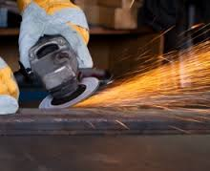
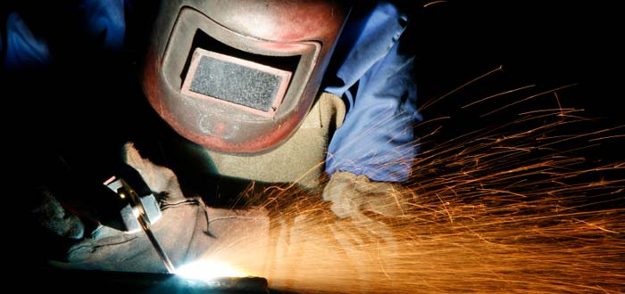
Manufacturing Facility
Total Area of the Premises : 15,000 Sq. Feet
Cover Shop Area : 3,000 Sq. Feet
Office Area : 400 Sq. Feet
Lifting Capacity : 7.5 Ton Lifting Capacity (Gantry Crane)
Welding Machine :
SMAW - 2 Nos.
GTAW - 2 nos.
Low Hydrogen SMAW welding consumable Backing Oven
Radial Drill Machine : 3 to Φ40 mm
Turning Lathe :Up to 14” OD and 4.5 Feet Bed Length.
Grinding Machine : Manual Grinding Machine.
Gas Cutting : Gas cutting facility up to 80 mm.
Testing Faculties
Hydrostatic test, Dry Penetrant Test (PT)
Radiography Test (UT), Ultrasonic Test (UT),
Magnetic Particle Inspection Test (MT)

Slide 6
Manufacturing Facility
Product Testing
ITOG Provides a variety of different types of testing that include, but are not limited to, hydro-testing, leak testing, liquid penetrant testing, ultrasonic testing, visual examinations, and radiographic testing. Final inspection and testing is performed on our pipe spools and skids before being shipped to the customer. This helps to ensure that we consistently supply the highest quality of products to our customers.
Project Management
The ITOG team relies on thorough project management from engineering throughout the delivery to ensure the highest level of success on each and every project that we handle.

Slide 7
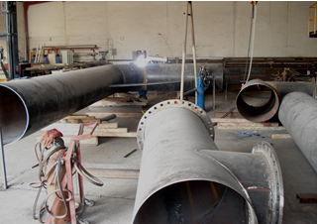
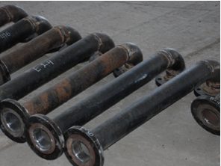
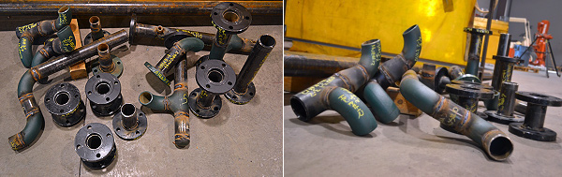
Product Photographs
Pipe Spools:

Slide 8
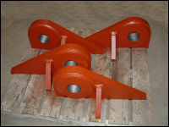
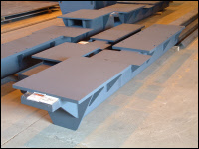
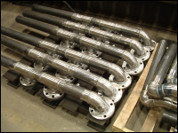
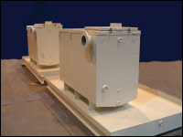
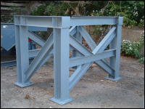
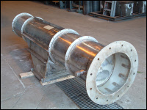
Product Photographs (Cont..)
Fabrication
Fabricated Lug
Motor Base
Pipe Weldment with heavy flanges
Hydraulic Lube Tanks
Customized Structure
Small Chimney/
Stack

Slide 9
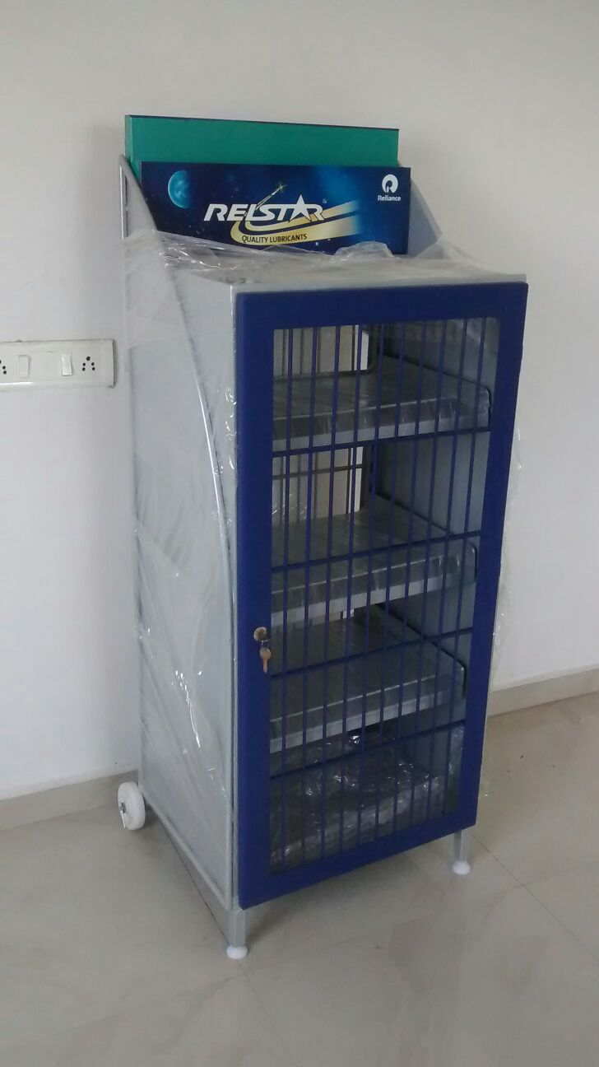
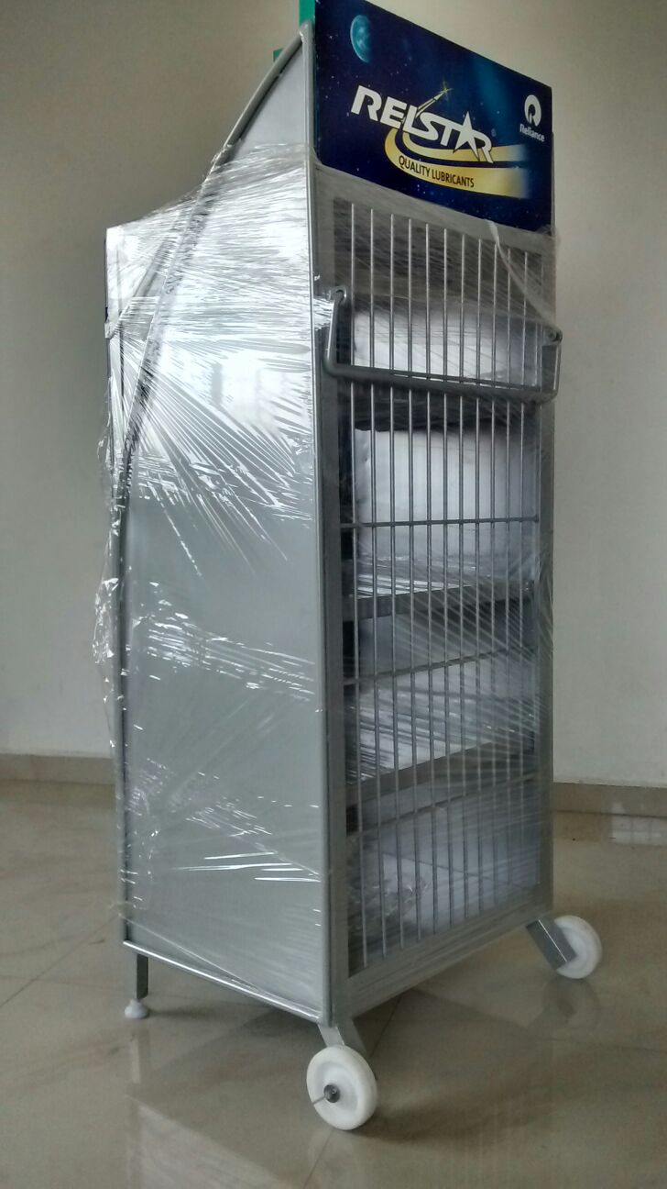
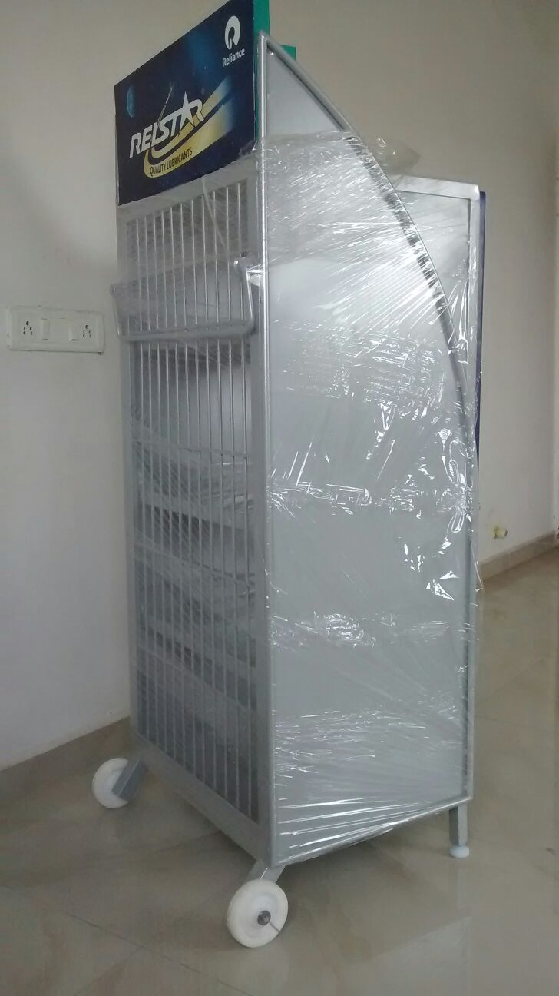
Product Photographs (Cont..)
Lubricant Display Units For Reliance Industries Limited

Slide 10
Product Photographs (Cont..)
MATERIAL HANDLING PRODUCTS

Slide 11
General Information:
Company Name : ITOG Engineering
Registered Office : Plot No. 2319, Phase-3,
G.I.D.C., Panoli, Ta: Ankleshwar,
Bharuch, Gujarat-394116, India
Factory Address : Same as above
Business Activities : Design, Engineering and Fabrication
Trading of all types of spare part
Banker Name : HDFC Bank, GIDC, Ankleshwar
Account No.: 50200010905422
NEFT / RTGS IFSC Code : HDFC0002677
GST/VAT No : 24211300822 dated 04.07.2015
CST/TIN No : 24711300822 dated 04.07.2015
Service Tax Reg No. : AAFFI1897LSD001 dated 19.06.2015
PAN : AAFFI1897L

Slide 12
Thank You

